Slide 1
Leveraging CLIP for Zero-Shot 2D Navigation
Gowri Shankar Raju Kurapati (gowri.kurapati@colorado.edu)
Research Statement Presentation
Notes:
Hi everyone,
Good Morning,
I am Gowri Shankar and today, I will be walking you through one of my research statements.
We will be navigating in a 2D grid world to by using a Visual-Language Model called CLIP in zero shot and without using any training step
and hence the title,
"Leveraging CLIP for zero-shot 2D navigation".

Slide 2
MOTIVATION

Slide 3
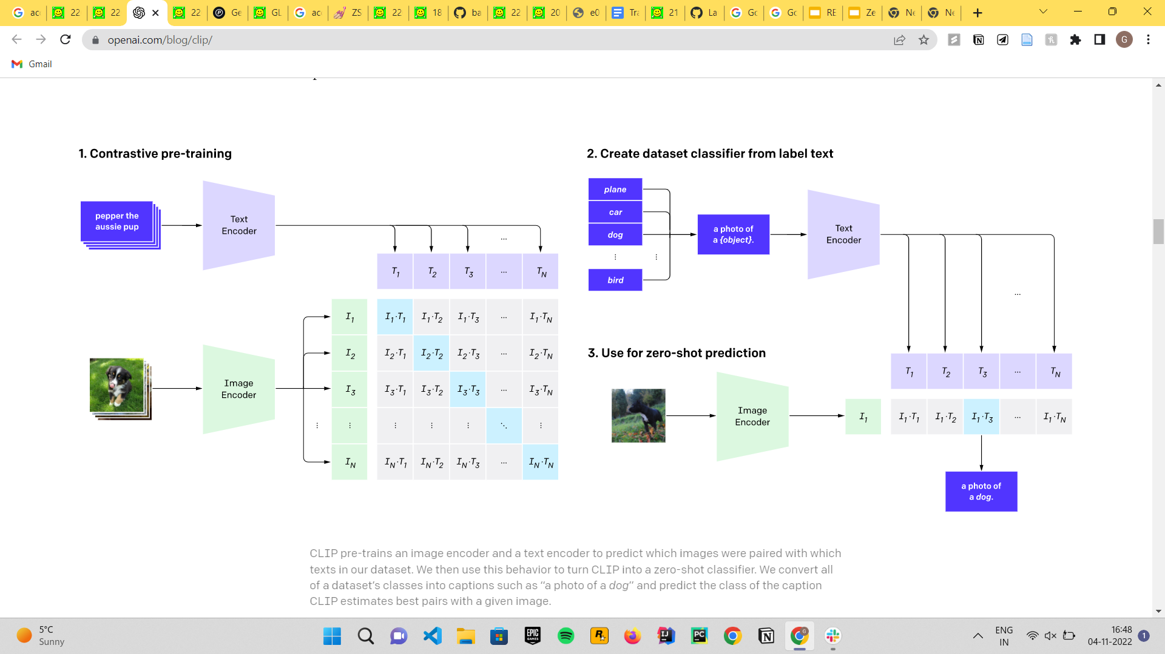
CLIP
(Contrastive Language–Image Pre-training)
Notes:
Firstly, Let us understand what CLIP is
It is a short form for " Contrastive Language-Image PreTraining".
As it is evident from the name, it is Language and Vision pre-trained model on 400M image caption pairs.
In short, it aligns the text and images by projecting them to a common latent space and optim model is trained to optimize a Symmetric Cross Entropy Loss over the similarity scores.
One of the ways of utilizing CLIP is zero shot Image Classification,
we can pass in any image , and compare the similarity scores against any texts like "A photo of a dog, A photo of a cat" etc ,and apply a softmax later to get the probability distribution over the given sentences.
//DONE, MOVE TO NEXT SLIDE
//IGNORE FROM HERE
It is pre trained on 400M Image-caption pairs from varied sources from the internet.
It has two encoders, one for encoding an Image and another for text. Image Encoder has ResNet50 or Vision Transformer Backbone, while the Text Encoder is a Transformer.
From the pre-training step, we can see n images and their corresponding n captions are converted to embeddings.
Similarity scores are calculated for every image embedding against every other text embedding. These scores are maximized along diagonal and minimized on upper-triangular and lower triangular matrices.
Note that the encoders are trained from scratch without using any pre-trained weights.
CLIP - https://openai.com/blog/clip/
Why CLIP is used ?
Pre -trained on 400M image - caption pairs from varied sources from the internet
Embeddings from Image Encoder(ResNet50 BackBone or Vision Transformer Backbone) and Text Encoder (Transformer) , projected to a common latent space
Optimize a symmetric cross entropy loss over these similarity scores
Zero Shot on Image Classification and even on unseen Objects

Slide 4
What more can CLIP do ?
Zero Shot Image Classification
Content Moderation ( CLIP can filter out graphic or NSFW images out of the box.)
Image search using text prompts(rclip)
Image Similarity and Ranking
Image Generation(LINK)
CLIP is recently being used in EMBODIED AI Tasks for Object Navigation in highly photorealistic & efficient 3D simulators such as RoboTHOR and HABITAT.
Though CLIP is used for embodied AI tasks, no work has been done on using CLIP for end - to - end TRAJECTORY prediction for 2D Navigation.
Notes:
There has a immense use of CLIP and its variants for various use cases like,
Zero Shot Image Classification, as we have seen before.
for context moderation
Image search using text prompts
Ranking of Images via similarity
and even Image Generation.
Recently, CLIP is also leveraged in embodied AI tasks for Object Navigation in 3D simulators. Previous research was using the RGB channels along with the Depth dimension to encode the image while recently, they utilize CLIP Image Embeddings (without the Depth Dimension) and achieve SOTA results on various Object navigation challenges.
But yet, no work has been done on leveraging CLIP for an end-to-end trajectory prediction for 2D navigation.

Slide 5
Hypothesis
Humans can navigate new environments by observing if their movements get them closer or farther away from their objective.
Without extensive random exploration, current models cannot do this zero-shot navigation.
We hypothesize that CLIP can be used for "language conditioned navigation in a 2D grid world"
Notes:
We people, navigate new places by assessing whether our steps are getting us closer to our goal.
Current models for 3D environments do an extensive random exploration and train during exploration to navigate the concerned environment.
But since
CLIP Image Embeddings are powerful to understand the surface level Image semantics and correlate well on a given text.,
we hypothesize that we can leverage CLIP for a "Language Conditioned Navigation in a 2D Grid world" in zero shot and bypassing the training step.

Slide 6
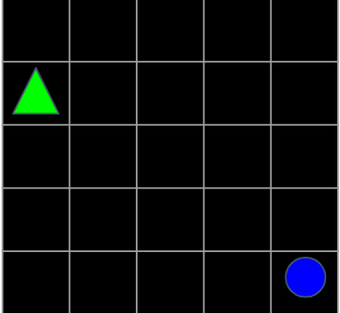
For example, let us assume a simple 2D grid world and say, we need to reach the BLUE CIRCLE from the present state (green triangle)
Notes:
For instance,
Consider the 2D grid world and say, we are trying to move the green triangle to the blue circle.

Slide 7
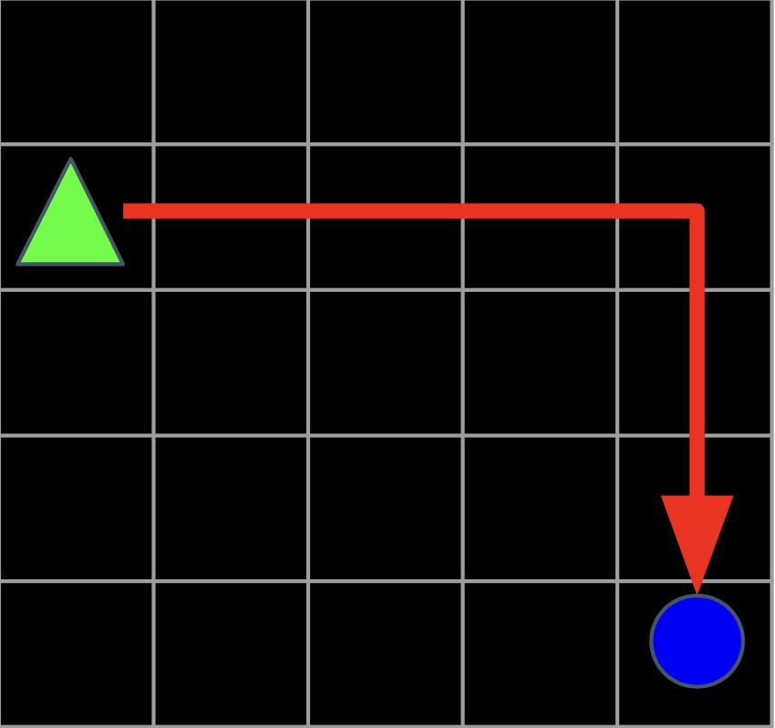
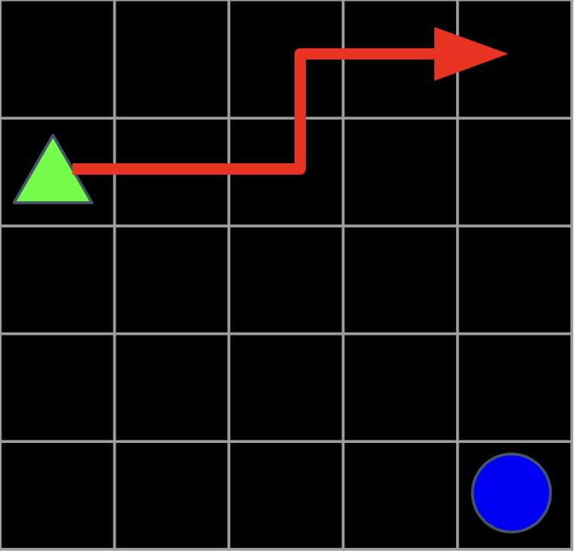
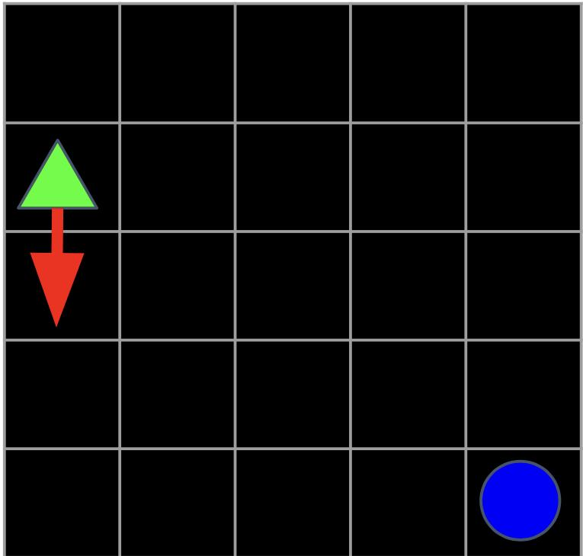
Example - 1
The triangle is connected to the circle
CLIP IMAGE ENCODER
CLIP TEXT ENCODER
T1
Actual Scores
CLIP IMAGE ENCODER
I1.T1
I2.T1
I3.T1
0.8819
0.0952
0.0229
I1
I2
I3
CLIP IMAGE ENCODER
Notes:
To illustrate,
let us consider three random states after a few time steps.,
We do that by placing an arrow connecting the green triangle to the current state and in this example we are considering three such random states.
The goal text is "The triangle is connected to the circle". We pass in each image on the left separately to the CLIP's pre-trained Image Encoder and find the similarty scores of the those embeddings against the text embedding.
As we can intuitively say, first image is expected to give you high similarity score and the last image to give the lowest score.
This expectation is VERIFIED by actually passing the same images and text to the CLIP , and normalized scores are displayed.
We 88% for first image and 9 and 2 for second and last image.
This little example is strengthening our initial hypothesis.

Slide 8
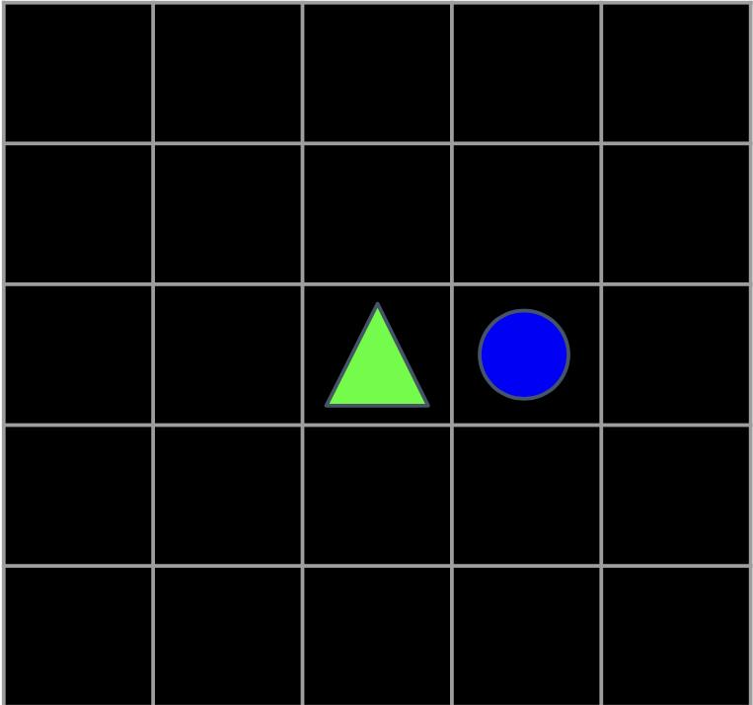
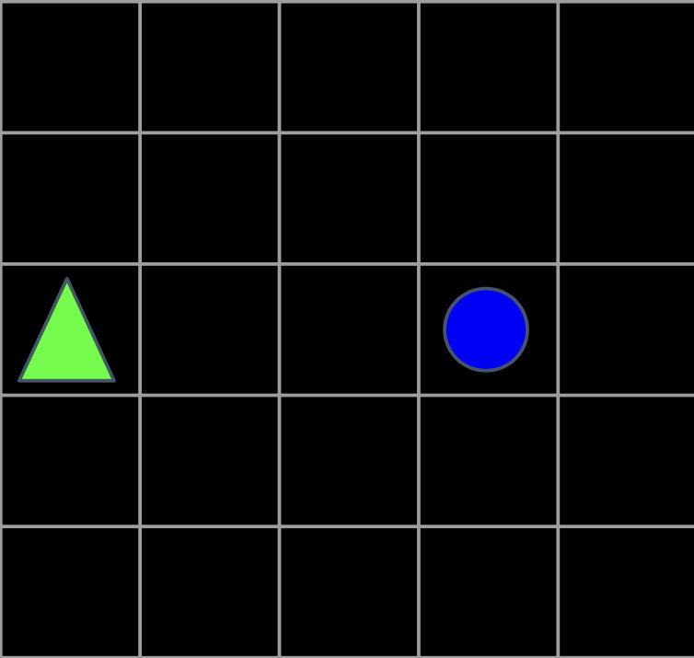
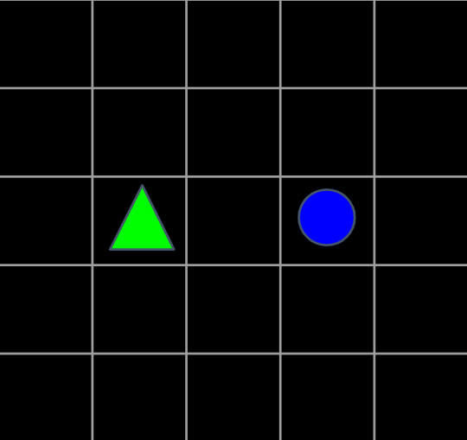
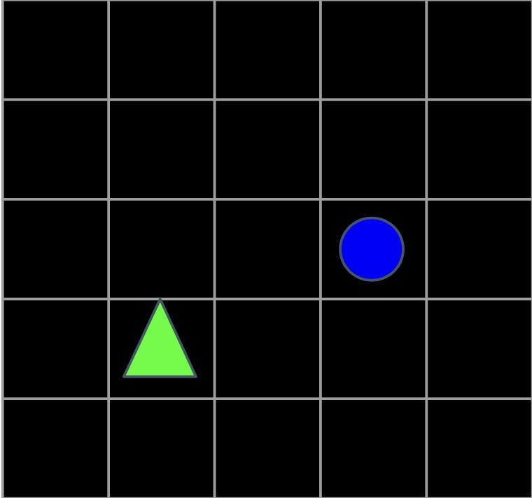
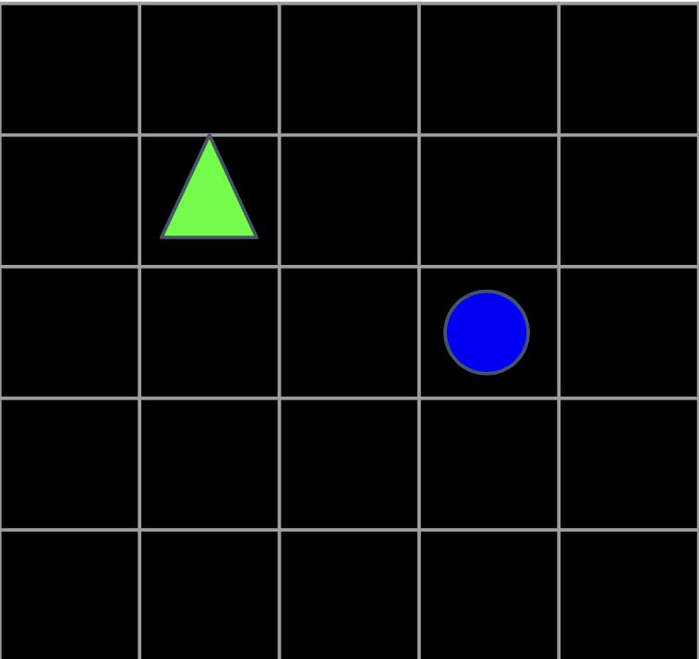
Example - 2
The triangle is connected to the circle
CLIP IMAGE ENCODER
CLIP TEXT ENCODER
If moved RIGHT
T1
Actual Scores
CLIP IMAGE ENCODER
LEFT
I1.T1
I2.T1
I3.T1
I4.T1
0.5948
0.1494
0.1101
0.1457
I1
DOWN
I2
CLIP IMAGE ENCODER
I3
If moved UP
I4
CLIP IMAGE ENCODER
Notes:
Let us consider another example,
where the current state of our 2D grid world is to the extreme left.
Suppose say that, we are trying to move green triangle to the blue circle.
the possible four states for the triangle are to move to left, right up and down, and corresponding 2 D grid worlds after potential moves are displayed
We then pass each of these image images individually to the image encoder. (notice that we don't have any red line showing the trajectory as we had in the previous exercise)
Now, We find the similarity scores for the image and the given text which is " The triangle is connected to the circe". , We expect the very first image to give high score as the triangle is very near to the circle.
We conducted this exercise on CLIP and actual scores correlate with what we expect.
To this end, my research statement is

Slide 9
RESEARCH STATEMENT
Notes:
Hello,
Welcome to
My name is Gowri Shankar.
Welcome

Slide 10

Research Statement
Can CLIP be used as a Navigator ?
What concepts of navigation does CLIP recognize ?
What concepts of navigation does CLIP not recognize ?
Notes:
Can CLIP be used as a navigator?
What topics of navigation does CLIP recognize ?
and what topics, it doesn't?

Slide 11
ENVIRONMENT, BASELINE & EVALUATION METRIC

Slide 12
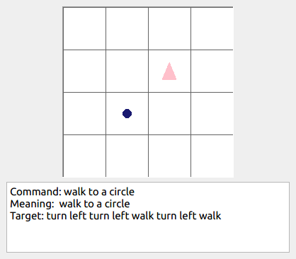
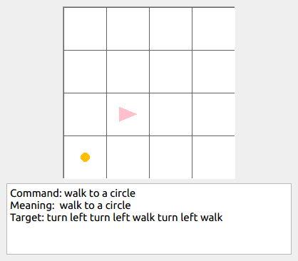
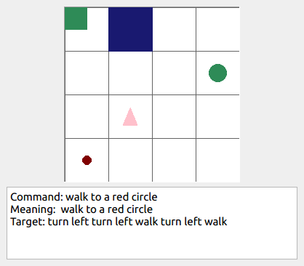
Environment
gSCAN Dataset(LINK)
Has customizable grid with different situations like following.
Notes:
For this project, we are trying to leverage two 2D environments.
gSCAN
BabyAI
Both of them have customizable grid with different situations
It has simple examples like displayed above.

Slide 13
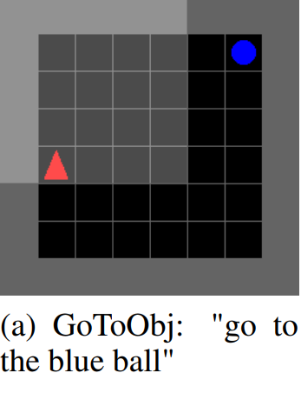
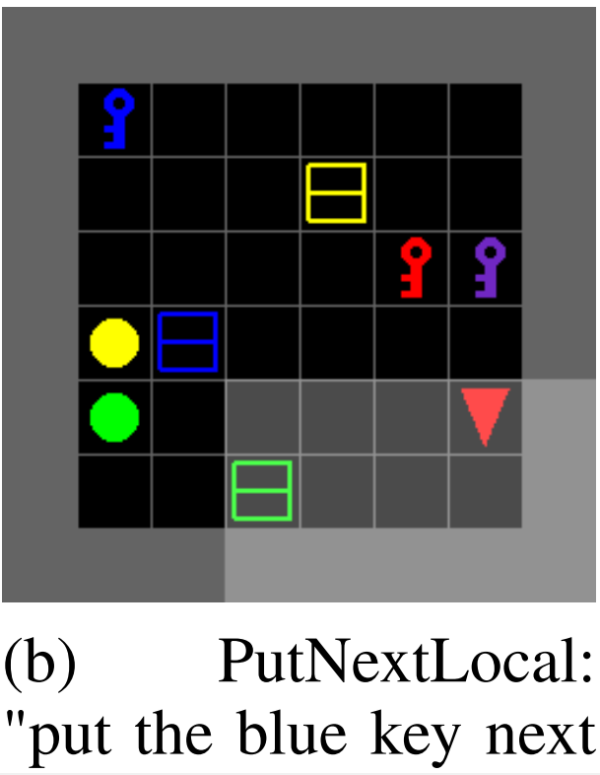
Environment
BabyAI Dataset(LINK)
Notes:
We are also looking at another environment called Baby AI, where the navigating object has to move to through several other objects.
A sample of the environments are displayed on the slide.

Slide 14
Baseline & Evaluation Metric
Baseline would be a simple LSTM/GRU Model to predict the next action . We will train the LSTM/GRU for the baseline while our approach requires no training at all.
Limited by the time steps, success rate would be the metric to evaluate.
Notes:
To the best of our knowledge,, there are no models out there to make a comparison and that is why, our baseline would be a simple LSTM/GRU model which takes in the image and text and predict the probability for next action of whether to move left/down/up/right.
Still our main approach doesn't require any training, as we will be leveraging the CLIP as it is.
The Evaluation metric would be the success rate of reaching the goal and this would be time-boxed based on number of steps taken.

Slide 15
Extensions
Use of Monte-Carlo Search Algorithm and A* Search for finding the optimal paths.
Notes:
One of the extensions for this project that we are currently thinking of is the use of Monte-Carlo Search Algorithm or A* search algorithm for finding the optimal paths.

Slide 16
THANK YOU
Gowri Shankar Raju Kurapati (110568555)
Research Statement Presentation

Slide 17
What more can CLIP do ?
CLIP Image Embeddings are POWERFUL!
Usually these embodied AI task used RGB-D to process the image of interest for navigation tasks.
But according to recent paper, Simple but Effective: CLIP Embeddings for Embodied AI, CLIP image embeddings can capture the below (WITHOUT Depth Dimension! (Just RGB Image)) better than
Reachability
Object Presence on a Grid (Localized)
Object Presence in a Image
Free Space
To this end, we ask the following questions which forms my research statement
Notes:
CLIP - https://openai.com/blog/clip/
Pre -trained on 400M image - caption pairs from varied sources from the internet
Embeddings from Image Encoder(ResNet50 BackBone or Vision Transformer Backbone) and Text Encoder (Transformer) , projected to a common latent space
Optimize a symmetric cross entropy loss over these similarity scores
Zero Shot on Image Classfication and even on unseen Objects

Slide 18
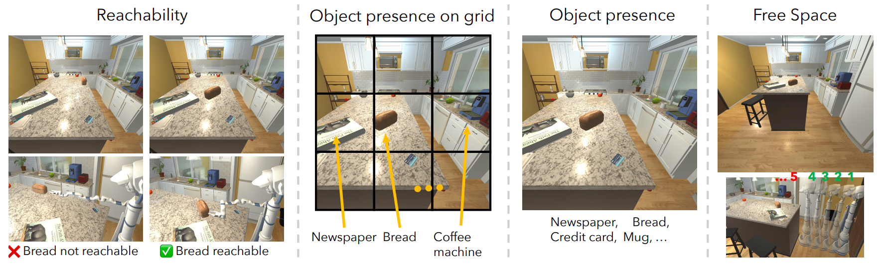

Slide 20

Contents
Motivation
Research Statement
Environment, BaseLines and Evaluation Metrics
Conclusion
Notes:
Hello,
My Name is Gowri Shankar Raju and I am prospective student for

Slide 21
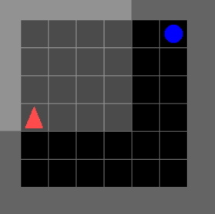
Next Plausible Step - Conditioned on GOAL TEXT and DIRECTION AS WELL
MOVE (RIGHT/LEFT/UP/BOTTOM) and Go to BLUE CIRCLE
CLIP TEXT ENCODER
Present State
T1
T2
T3
T4
CLIP IMAGE ENCODER
I1
I1.T1 | I1.T2 | I1.T3 | I1.T4

